Slide 1

Futurense
Democratizing Tech Talent to deliver impact at scale

Slide 2

Analysis of HealthCare Data
Made by :
Lokesh Kumar
FT613

Slide 3
Index :
Overview
Tools and Technologies used
Statistics
Code Overview
Visualization
Future Scope

Slide 4
Overview:
Processing the 2011 census data to find some relevant information about the healthcare department.
the values of some of data is missing ,that we have found by using data from other fields.
Analysis after processing and filling the missing values on healthcare data.

Slide 5




Tools and Technologies Used:
Tool 1
Tool 2
Tool 3

Slide 6
Libraries/Packages/Features Used:
Pandas
Matplotlib
Pymysql / Sqlalchemy
RDS on AWS
GIT & GITHUB

Slide 7

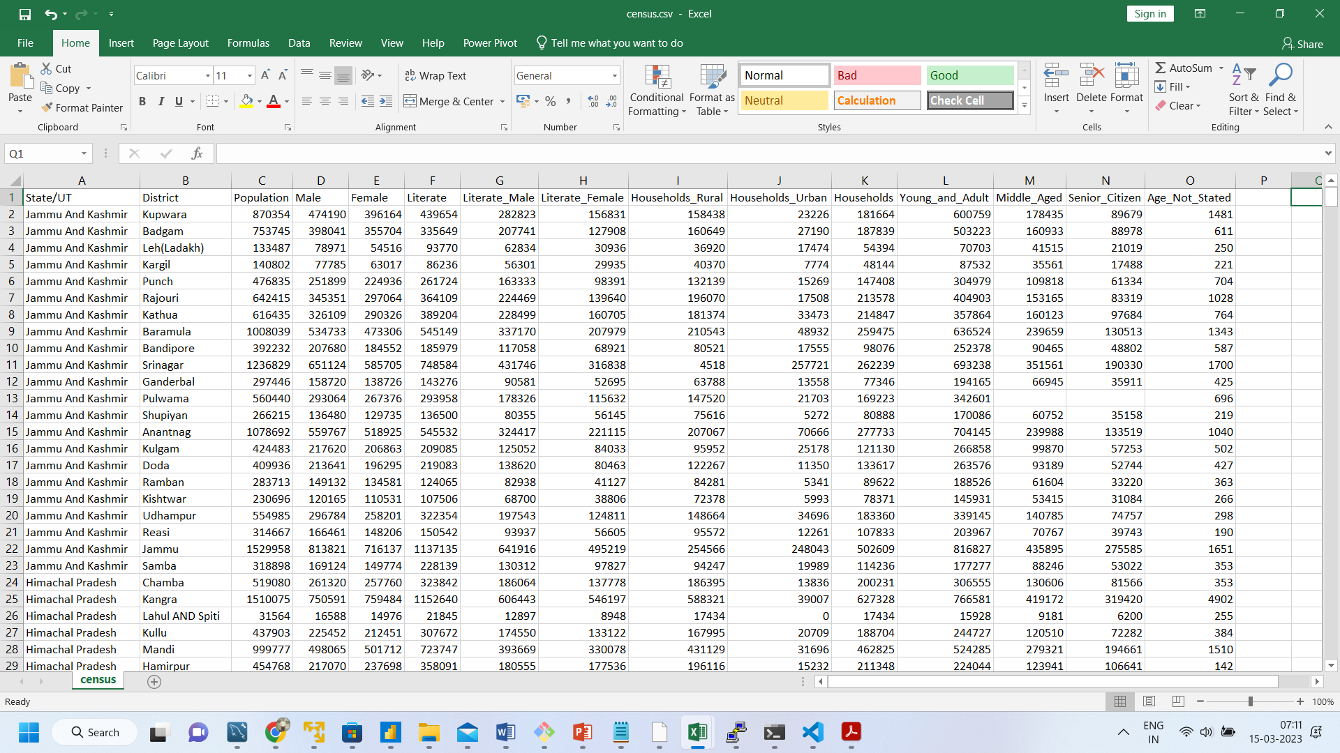
Step 1: Dump Unwanted Columns
we have left with a Dataframe that is only 15 columns down from 118 columns
Rename the Column names
New State/UT formation
Telangana formed in 2014
Laddakh formed in 2019

Slide 8
Step 2: Data Cleaning
Find and process the Missing Data for the columns
Population = Male + Female
Literate = Literate_Male + Literate_Female
Population = Young_and_Adult+ Middle_Aged + Senior_Citizen + Age_Not_Stated
Households = Households_Rural + Households_Urban

Slide 9
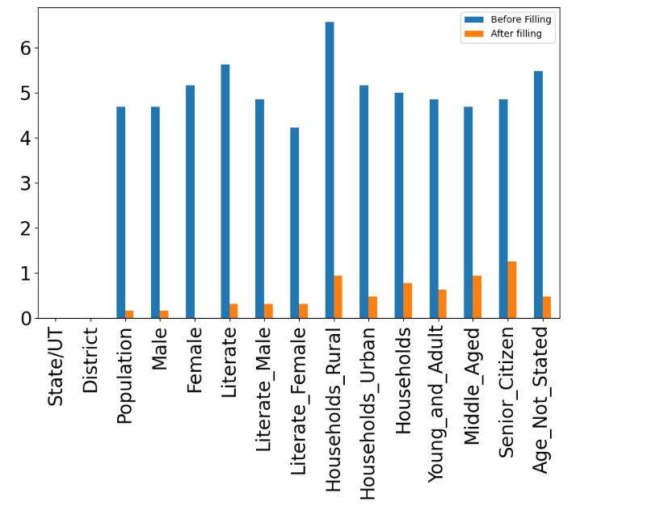
Ratio of Missing Data- before and after cleaning

Slide 10
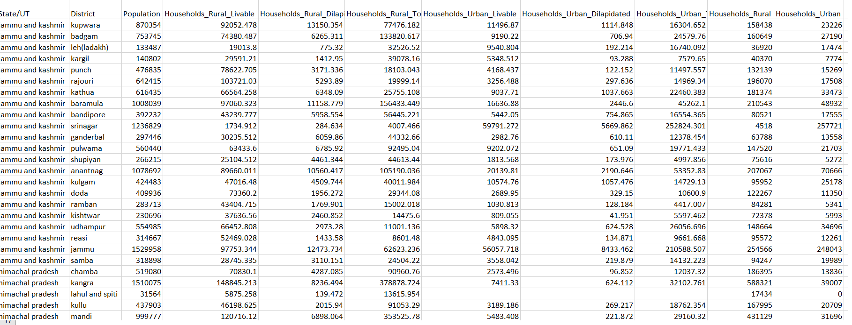
Step 3: Process the relevant data of Housing Dataset
Column Renaming
State/UT renaming
Updated State of Telangana and Laddakh

Slide 11
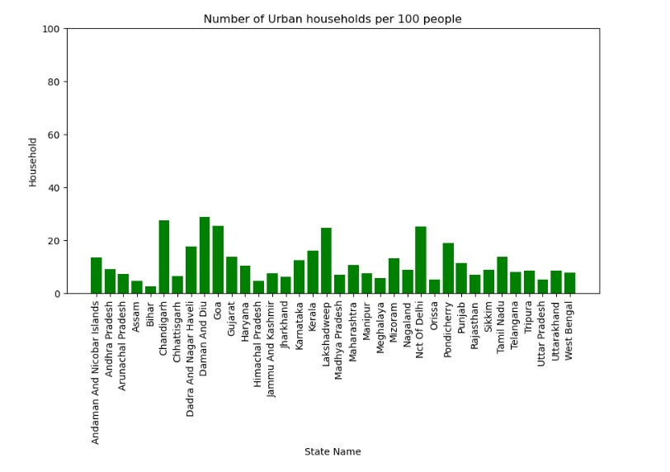
Step 4: Visualization based on cleaned data
Number of Urban households per 100 people

Slide 12
Step 4: Visualization based on cleaned data
Number of Urban households per 100 people

Slide 13
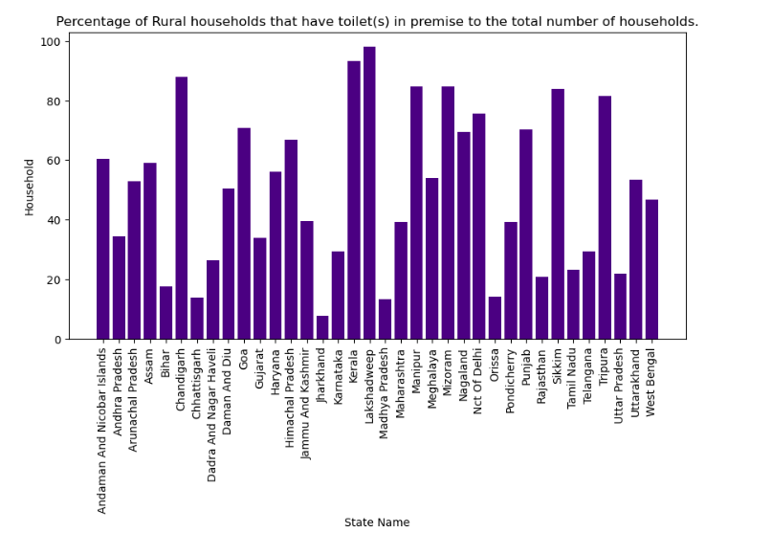
Step 4: Visualization based on cleaned data
Percentage of Rural households that have toilet(s) in premise to the total number of households

Slide 14
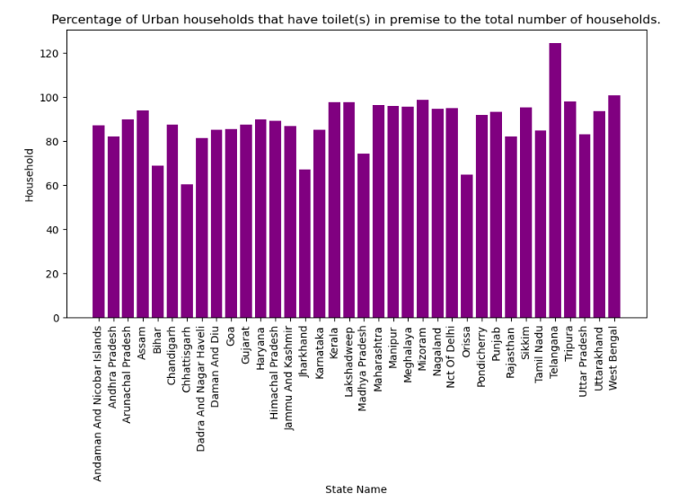
Step 4: Visualization based on cleaned data
Percentage of Urban households that have toilet(s) in premise to the total number of households

Slide 15
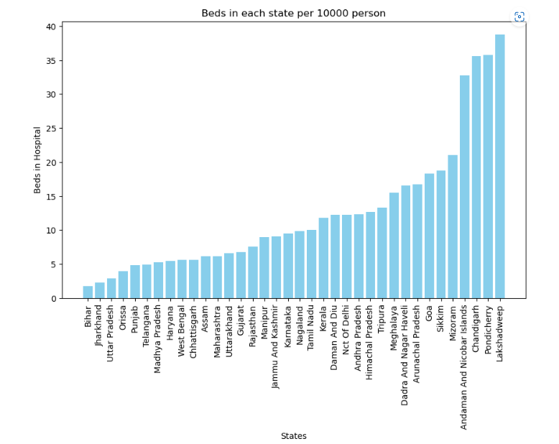
Step 4: Visualization based on cleaned data
Beds Available in each state per 10000 person

Slide 16
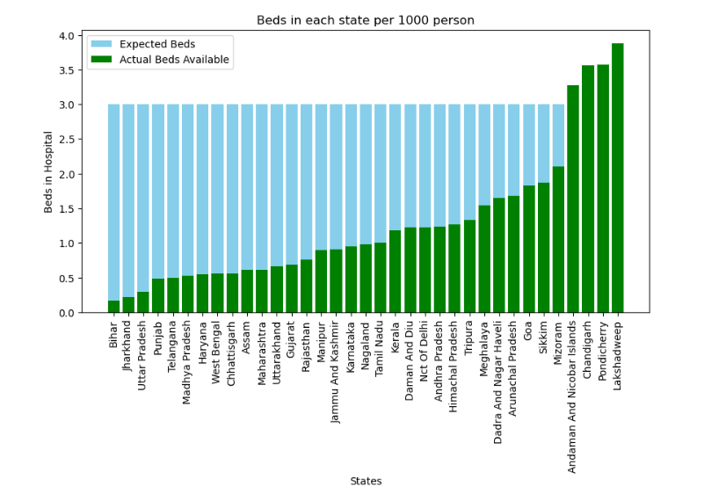
Step 4: Visualization based on cleaned data
Beds in each state per 1000 person
vs WHO standard guidelines

Slide 17
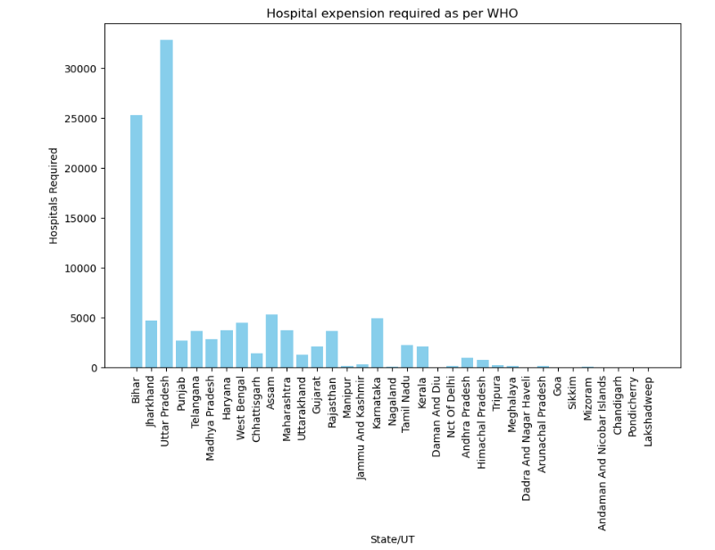
Step 4: Visualization based on cleaned data
Hospital expansion required as per WHO guidelines

Slide 18
Highlights & Standout Features:
States having less hospital
Bihar
Jharkhand
Uttar Pradesh

Slide 19
Highlights & Standout Features:
States fulfilling WHO standards
Lakshadweep
Pondicherry
Chandigarh
Andaman and Nicobar Island

Slide 20
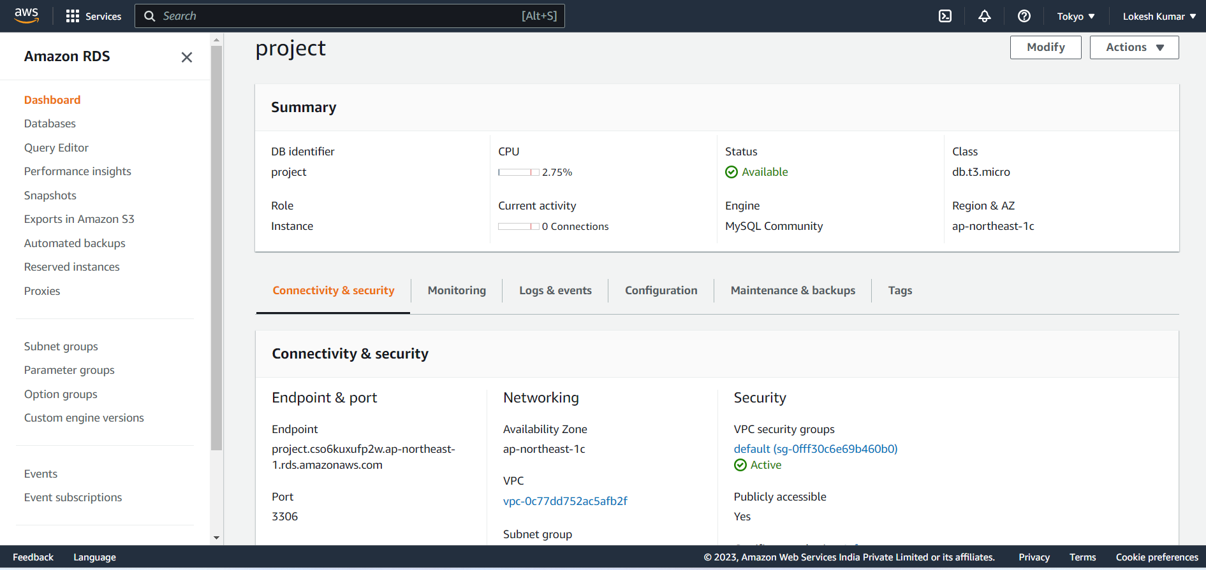
RDS Connection
Host –admin
Port – 3306
Database - project

Slide 21
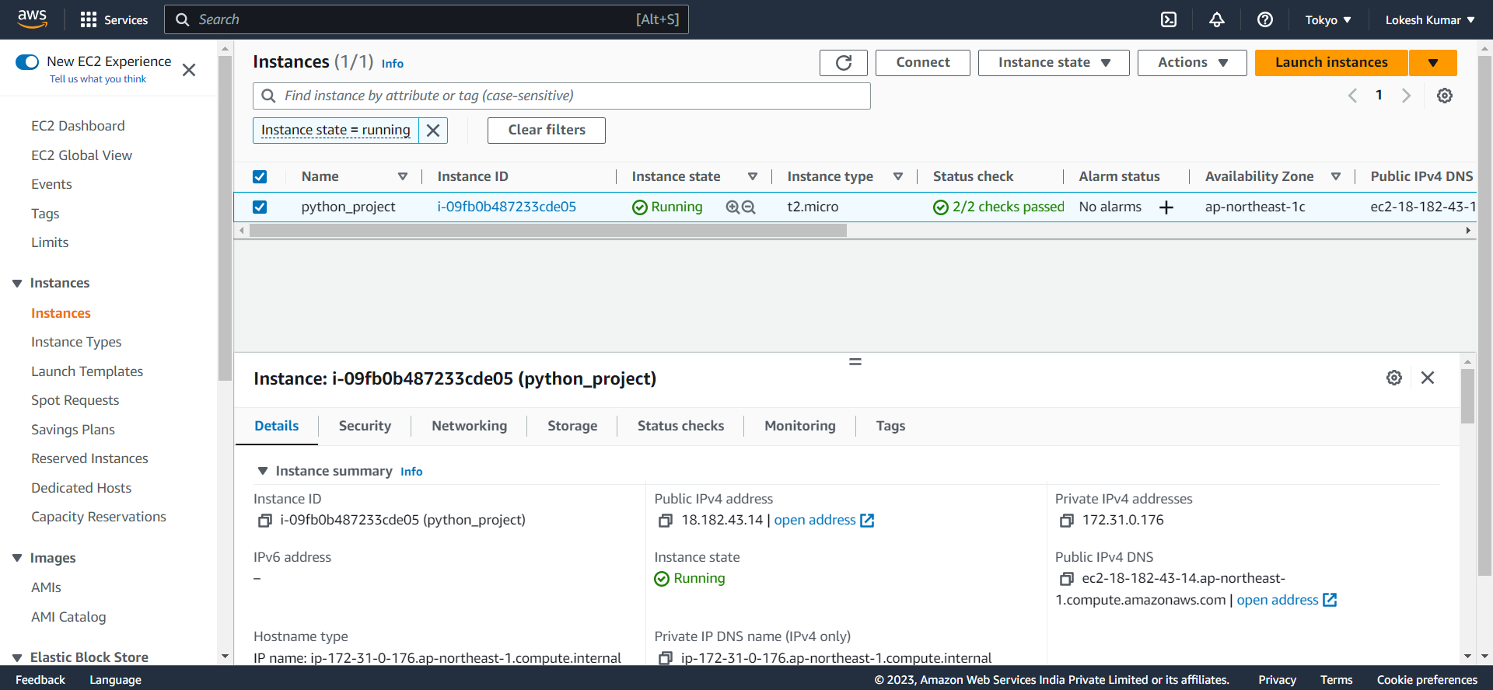
EC2 connection

Slide 22
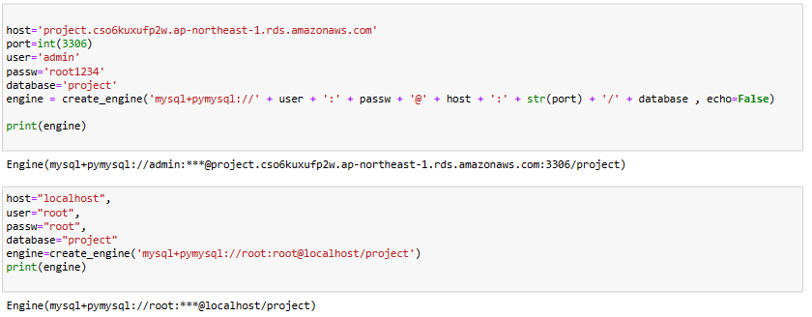
SQL Connection
RDS connection
Localhost connection

Slide 23
Future Scope:

Slide 24
Thank You

Slide 25


















